Slide 1
Android SIG December Meeting
December 09, 2022

Slide 2


Slide 3
Agenda
RISCV64 patches summary
Repo update
Cuttlefish(VM) on RISCV64

Slide 4
RISCV64 patches summary format
Merged patches：
https://android-review.googlesource.com/q/riscv64+after:2022-9-29+-branch:main-16k++-owner:%2522Android+Culprit+Assistant%2522 [android-review.googlesource.com]
Patches not merged：
https://android-review.git.corp.google.com/q/riscv64+status:open+after:2022-9-29+-branch:main-16k++-owner:%2522Android+Culprit+Assistant%2522 [android-review.git.corp.google.com]

Slide 5
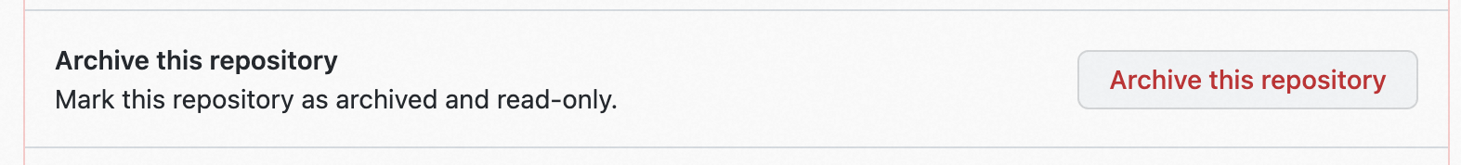
Repo update
New collaborative repo naming
“RISC-V Android Source” -> “RISC-V Android”
riscv-android-src -> riscv-android
Old GITs repo retirement
Snapshot for a reference
Using “Archive this repository”

Slide 6
Cuttlefish(VM) on RISCV64
u-boot & kernel build is okay
https://android-review.googlesource.com/c/device/google/cuttlefish/+/2308540
Owner:
Adelva(Google)

Slide 7
Gap analysis
Doc format
Doc(https://docs.google.com/document/d/1e39VfJFtersJPOyNuwODALQOBHYY_YtwkkAwhGOEdas/edit#heading=h.150v9cvcuyg8)
Slides(https://docs.google.com/presentation/d/1RBcRB41d0qZsVP6TrE9jnsPUQyoE493mgOoL75m5jeQ/edit#slide=id.g10f5e2d066f_1_239)
Spreadsheets(https://docs.google.com/spreadsheets/d/1NtWr70UC9GfW3kOP9tGJYA34ecHxySXW_EQ3RsfMR18/edit#gid=0)
Issues with tags(https://github.com/ClangBuiltLinux/linux/issues) can export to single doc with tool
Gaps: https://docs.google.com/spreadsheets/d/1HifwLJCBeLxgtXo-D1O1POlsBlybRokCmAj3yljq9NM/edit?pli=1#gid=0

Slide 8
Thank You

